Slide 1
Chapter 5

Slide 2
What is Scala?
Scala, short for Scalable Language, is a hybrid functional programming language.
Scala is a pure object-oriented language in the sense that every value is an object. Types and behavior of objects are described by classes and traits which will be explained in subsequent chapters.
Classes are extended by subclassing and a flexible mixin-based composition mechanism as a clean replacement for multiple inheritance.
Scala is also a functional language in the sense that every function is a value and every value is an object so ultimately every function is an object.
Scala provides a lightweight syntax for defining anonymous functions, it supports higher-order functions, it allows functions to be nested, and supports currying.

Slide 3
What is Scala?
Scala is compiled into Java Byte Code which is executed by the Java Virtual Machine (JVM). This means that Scala and Java have a common runtime platform. You can easily move from Java to Scala.

Slide 4
Scala Operators
An operator is a symbol that tells the compiler to perform specific mathematical or logical manipulations. Scala is rich in built-in operators and provides the following types of operators −
Arithmetic Operators
Relational Operators
Logical Operators
Bitwise Operators
Assignment Operators

Slide 5
Basic Variable/Data types
Sr.No | Data Type & Description
1 | Byte 8 bit signed value. Range from -128 to 127
2 | Short 16 bit signed value. Range -32768 to 32767
3 | Int 32 bit signed value. Range -2147483648 to 2147483647
4 | Long 64 bit signed value. -9223372036854775808 to 9223372036854775807
5 | Float 32 bit IEEE 754 single-precision float
6 | Double 64 bit IEEE 754 double-precision float

Slide 6
Basic Variable types
Sr.No | Data Type & Description
7 | Char 16 bit unsigned Unicode character. Range from U+0000 to U+FFFF
8 | String A sequence of Chars
9 | Boolean Either the literal true or the literal false
10 | Unit Corresponds to no value
11 | Null null or empty reference
12 | Nothing The subtype of every other type; includes no values
13 | Any The supertype of any type; any object is of type Any
14 | AnyRef The supertype of any reference type

Slide 7
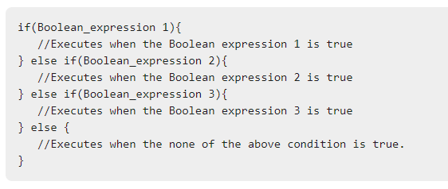
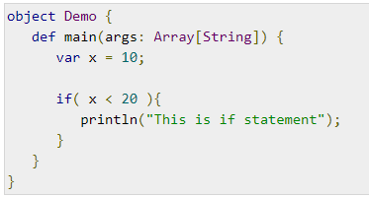
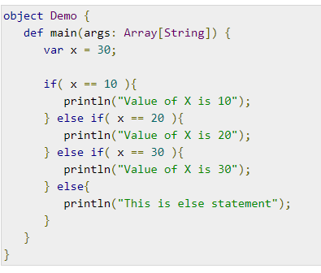
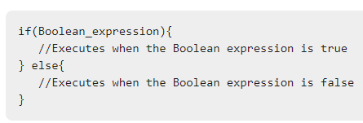
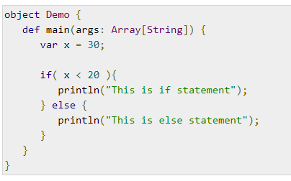
control structure
If and If else Statements:
if(Boolean_expression) { // Statements will execute if the Boolean expression is true }

Slide 8

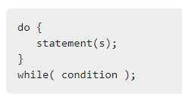
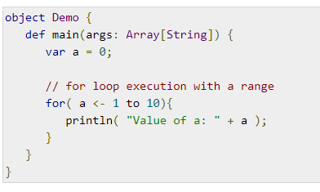
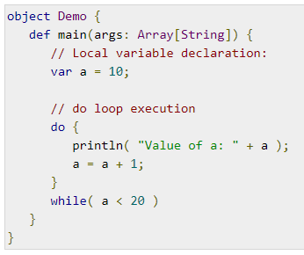
for each loop

Slide 9
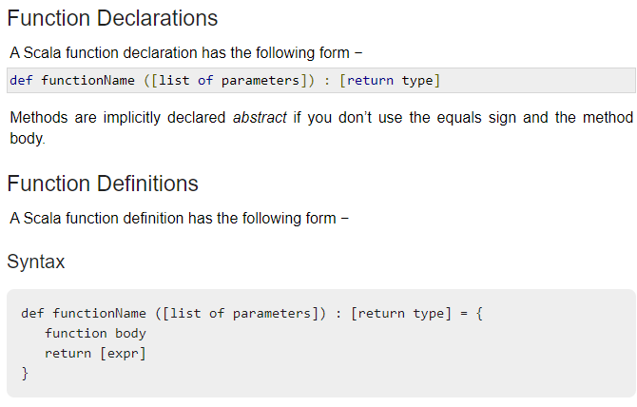
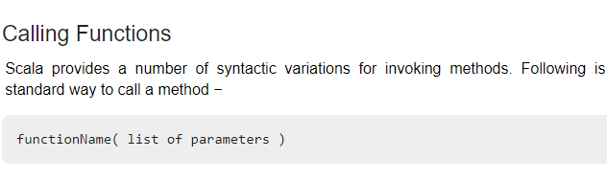
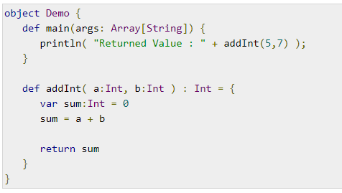
Functions
A function is a group of statements that perform a task. You can divide up your code into separate functions. How you divide up your code among different functions is up to you, but logically, the division usually is so that each function performs a specific task.

Slide 10
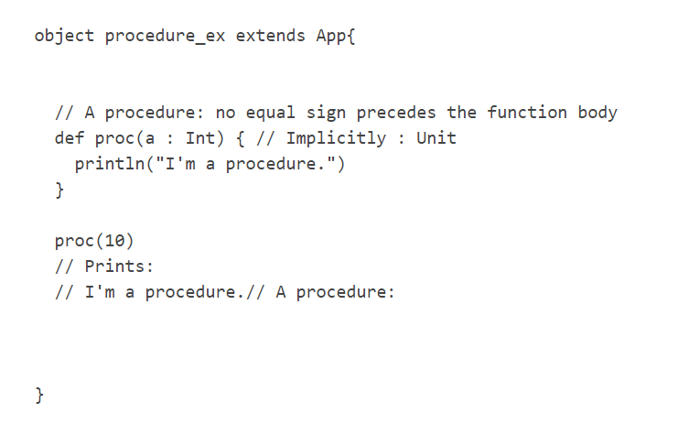
Procedures
The functions which don’t return anything in Scala, they are called procedures.

Slide 11
constructor
Scala constructor is used for creating an instance of a class. There are two types of constructor in Scala – Primary and Auxiliary. Not a special method, a constructor is different in Scala than in Java constructors. The class’ body is the primary constructor and the parameter list follows the class name. The following, then, is the default primary constructor.
A class in Scala may have only one primary constructor. Such a constructor may have zero or more parameters.
A class may have any number of auxiliary constructors. You must make sure that it must make a call to another auxiliary constructor or to the primary constructor in the first line of its body.

Slide 12
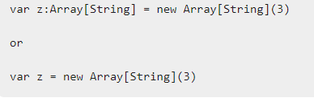

Array
Scala provides a data structure, the array, which stores a fixed-size sequential collection of elements of the same type. An array is used to store a collection of data, but it is often more useful to think of an array as a collection of variables of the same type.
To use an array in a program, you must declare a variable to reference the array and you must specify the type of array the variable can reference.

Slide 13
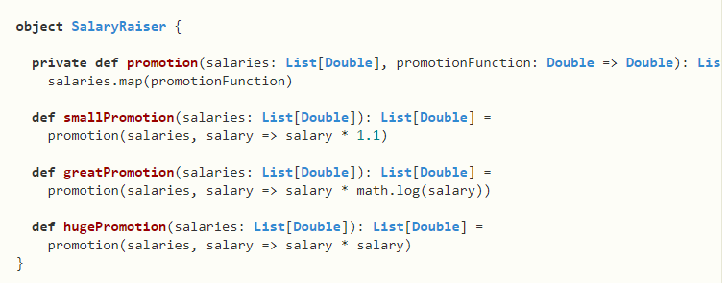
Higher order functions
Higher order functions take other functions as parameters or return a function as a result. This is possible because functions are first-class values in Scala. The terminology can get a bit confusing at this point, and we use the phrase “higher order function” for both methods and functions that take functions as parameters or that return a function.

Slide 14
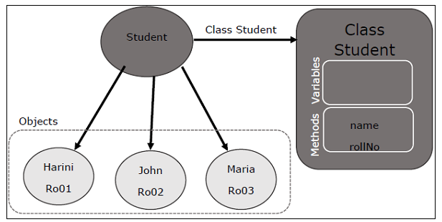
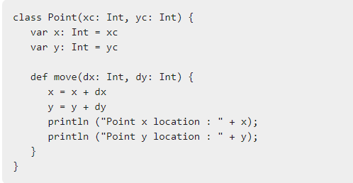
Class in Scala
A class is a blueprint for objects. Once you define a class, you can create objects from the class blueprint with the keyword new. Through the object you can use all functionalities of the defined class.

Slide 15
getters and setters
Getter and Setter in Scala are methods that helps us to get the value of variables and instantiate variables of class/trait respectively. Scala generates a class for the JVM with a private variable field and getter and setter methods. In Scala, the getters and setters are not named getXxx and setXxx, but they are used for the same purpose. At any time, we can redefine the getter and setter methods ourself.
Setter are a technique through which we set the value of variables of a class. Setting an variable of class is simple it can be done in two ways :-
First if the members of a class are accessible from anywhere. i.e no access modifier specified.
Second if the members of a class are defined as private. Initiation of the variables is done by passing the variable to public method of that class using the object of the class.

Slide 16
Singleton
Scala is more object oriented language than Java so, Scala does not contain any concept of static keyword. Instead of static keyword Scala has singleton object. A Singleton object is an object which defines a single object of a class. A singleton object provides an entry point to your program execution. If you do not create a singleton object in your program, then your code compile successfully but does not give output. So you required a singleton object to get the output of your program. A singleton object is created by using object keyword.
Syntax:
object Name{
// code...
}

Slide 17
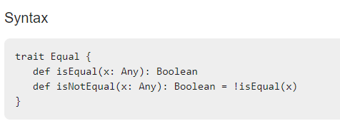
Trait
A trait encapsulates method and field definitions, which can then be reused by mixing them into classes. Unlike class inheritance, in which each class must inherit from just one superclass, a class can mix in any number of traits.
Traits are used to define object types by specifying the signature of the supported methods. Scala also allows traits to be partially implemented but traits may not have constructor parameters.

Slide 18


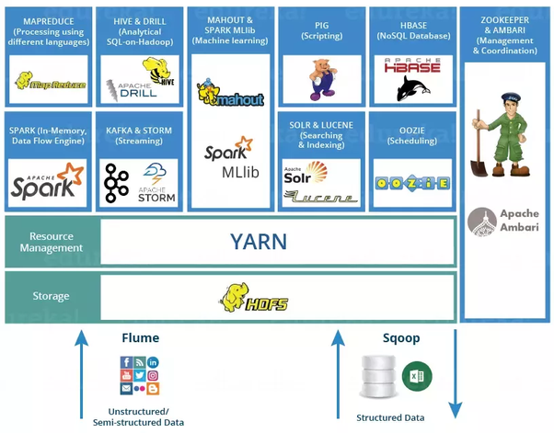
Hadoop technology stack

Slide 19

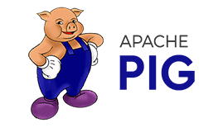

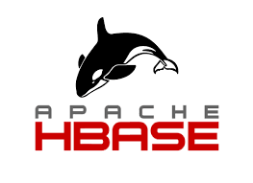

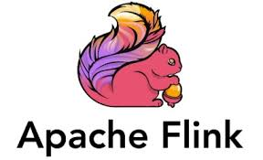



Big data analytics Tools
Batch Data Analysis
Streaming Data Analysis

Slide 20
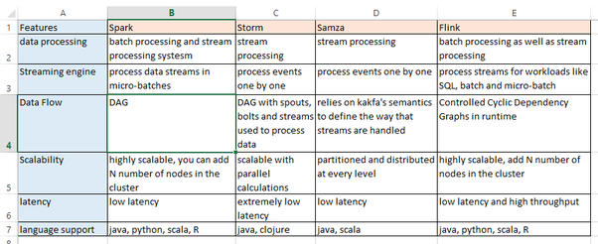
Big data analytics Tools

Slide 21
Introduction to Apache Spark
Apache Spark is a Opensource general-purpose framework for cluster computing,
It is used for a diverse range of applications.
cluster computing in Spark designed to be fast and general-purpose.
Spark can run in Hadoop clusters and access any Hadoop data source, including Cassandra.
Spark is written in Scala but provides rich APIs support using Scala, Java, Python, and R.

Slide 22

Advantages of Apache Spark
In Memory computing
Speed
Advanced analytics
Supporting Multiple Languages
Real-time Stream processing
Cost Efficient
Fault tolerance
Reusability
Lazy Evaluation
Scalable

Slide 23
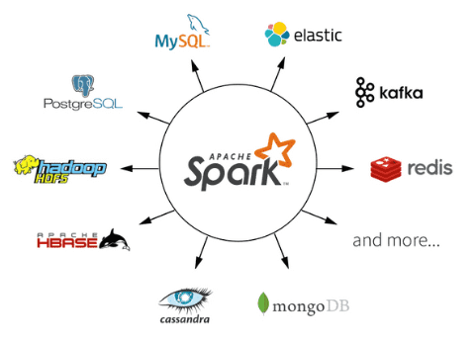
Organizations using Python
Company's Using Apache Spark
Yahoo (Finance)
Google (App Engine)
eBay
NASA
Netflix
Nokia
IBM
Amazon
Facebook
Salesforce
……and So on

Slide 24
Spark Framework
Scala
Python
R
Java
Spark SQL
Structured data
Spark Streaming
Realtime
MLib
Machine Learning
Graph X
Graph processing
Spark Core
Standalone Spark Schedular
YARN
Mesos

Slide 25


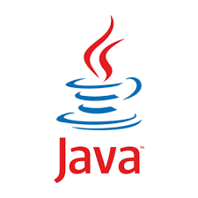
Spark Framework Stack
Programming
Support
Libraries
Spark SQL
Structured data
MLib
Machine Learning
Graph X
Graph processing
Spark Streaming
Realtime
Computational
Engine
Spark Core
Cluster
Managers
Standalone Spark Schedular
YARN
Mesos
Kubernetes
Storage
Local
HDFS
S3
RDBMS
NOSQL

Slide 26
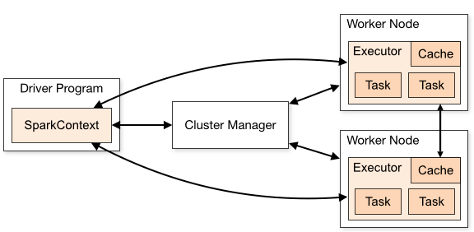
Spark Architecture
Source: https://spark.apache.org/

Slide 27
Spark Modes
Batch Mode
Spark Modes
Interactive Mode
Streaming Mode

Slide 28
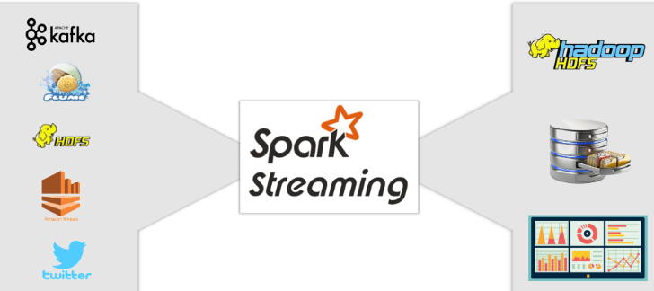
Spark Modes

Slide 29
Major Concepts in Apache Spark
SparkContext
Data Frame
Shared Variables
Lazy Evaluation
Concepts
Broadcast
Accumulators
RDD
Transformations
Actions

Slide 30
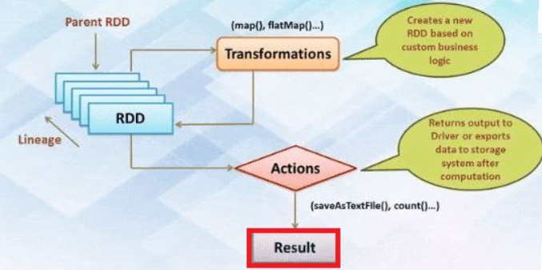
Major Concepts in Apache Spark
Lazy evaluation

Slide 31
RDD Apache Spark
RDD stands for “Resilient Distributed Dataset”
It is the fundamental data structure of Apache Spark.
RDD in Apache Spark is an immutable collection of objects which computes on the different node of the cluster.
Resilient, i.e. fault-tolerant with the help of RDD lineage graph(DAG) and so able to recompute missing or damaged partitions due to node failures.
Distributed, since Data resides on multiple nodes.
Dataset represents records of the data you work with. The user can load the data set externally which can be either JSON file, CSV file, text file or database via JDBC with no specific data structure.

Slide 32

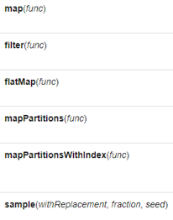
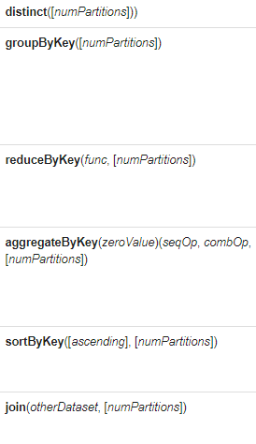
Transformations in Apache Spark
Wide Transformations
Narrow Transformations

Slide 33
Introduction to PySpark
Apache Spark is an open-source cluster-computing framework, built around speed, ease of use, and streaming analytics whereas Python is a general-purpose, high-level programming language.
PySpark is a Python API for Spark that lets you harness the simplicity of Python and the power of Apache Spark in order to handle Big Data problems.
PySpark provides a wide range of libraries and is majorly used for Machine Learning and Real-Time Streaming Analytics.

Slide 34
IDEs for PySpark
Spider
PyCharm
Pyspark Shell
Popular Python Sparks IDEs
Jupyter Notebook
IntelliJ idea
Atom

Slide 35
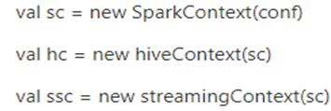
Spark Context
SparkContext is used as a channel to access all spark functionality.
The spark driver program uses spark context to connect to the cluster through a resource manager
sparkConf is required to create the spark context object, which stores configuration parameter like appName (to identify your spark driver), application, number of core and memory size of executor running on worker node.
val conf = new SparkConf().setAppName(“Retaildata Analysis”) .setMaster(“spark://master:7077”).set(“spark.executor.memory”, “2g”)

Slide 36
Spark Session
SparkSession provides a single point of entry to interact with underlying Spark functionality
It allows programming Spark with DataFrame and Dataset APIs.
All the functionality available with sparkContext are also available in sparkSession.
In order to use APIs of SQL, HIVE, and Streaming, no need to create separate contexts as sparkSession includes all the APIs.
val spark = SparkSession.builder.appName(“WorldBankIndex”).getOrCreate()
spark.conf.set(“spark.sql.shuffle.partitions”, 6) spark.conf.set(“spark.executor.memory”, “2g”)

Slide 37
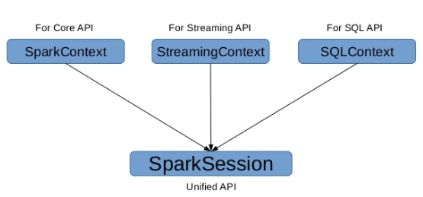
Spark Session

Slide 38
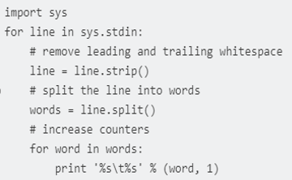
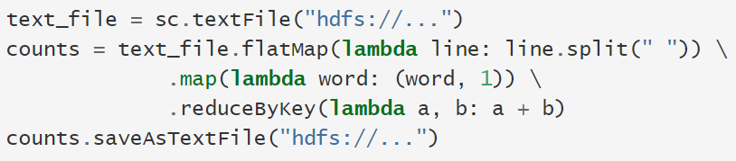
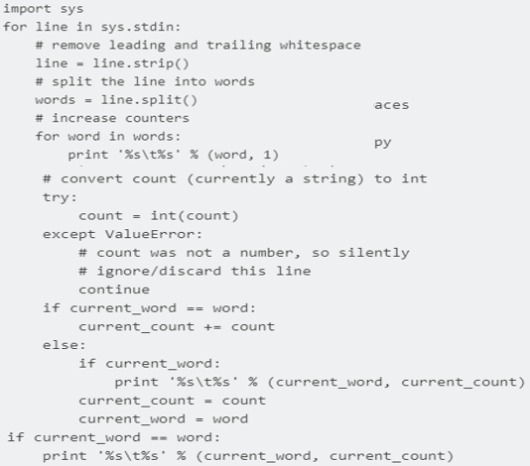
Wordcount Applications
PySpark
Python

Slide 39
Key-Value Pair RDDs
Spark Paired RDDs are nothing but RDDs containing a key-value pair. Basically, key-value pair (KVP) consists of a two linked data item in it. Here, the key is the identifier, whereas value is the data corresponding to the key value.
Moreover, Spark operations work on RDDs containing any type of objects. However key-value pair RDDs attains few special operations in it. Such as, distributed “shuffle” operations, grouping or aggregating the elements by a key.
In addition, on Spark Paired RDDs containing Tuple2 objects in Scala, these operations are automatically available. Basically, operations for the key-value pair are available in the Pair RDD functions class. However, that wraps around a Spark RDD of tuples.

Slide 40
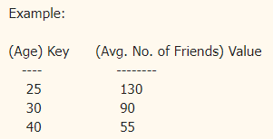
Key-Value Pair RDDs
A key/value pair is a set of two data items:
1) Key: which is a unique identifier for a value
2) Value: which is the data that is identified by the Key
Key/Value pair is the common data type in Spark that is required for many operations. And it is most commonly used for aggregation. And in Spark, the key/Value pair is represented as a tuple with two elements. Example: (25, 130) , (30, 90) and (40, 55). The first element is called Key and the second element is called Value.

Slide 41
RDD Persistence
Spark RDD persistence is an optimization technique in which saves the result of RDD evaluation. Using this we save the intermediate result so that we can use it further if required. It reduces the computation overhead.
We can make persisted RDD through cache() and persist() methods. When we use the cache() method we can store all the RDD in-memory. We can persist the RDD in memory and use it efficiently across parallel operations.
The difference between cache() and persist() is that using cache() the default storage level is MEMORY_ONLY while using persist() we can use various storage levels (described below). It is a key tool for an interactive algorithm. Because, when we persist RDD each node stores any partition of it that it computes in memory and makes it reusable for future use. This process speeds up the further computation ten times.
When the RDD is computed for the first time, it is kept in memory on the node. The cache memory of the Spark is fault tolerant so whenever any partition of RDD is lost, it can be recovered by transformation Operation that originally created it.

Slide 42
RDD Persistence
There are some advantages of RDD caching and persistence mechanism in spark. It makes the whole system
Time efficient
Cost efficient
Lesser the execution time.

Slide 43
SPARK SQL
Spark SQL is a component on top of Spark Core that introduces a new data abstraction called SchemaRDD, which provides support for structured and semi-structured data.
Spark introduces a programming module for structured data processing called Spark SQL. It provides a programming abstraction called DataFrame and can act as distributed SQL query engine.

Slide 44
SPARK SQL
The following are the features of Spark SQL −
Integrated − Seamlessly mix SQL queries with Spark programs. Spark SQL lets you query structured data as a distributed dataset (RDD) in Spark, with integrated APIs in Python, Scala and Java. This tight integration makes it easy to run SQL queries alongside complex analytic algorithms.
Unified Data Access − Load and query data from a variety of sources. Schema-RDDs provide a single interface for efficiently working with structured data, including Apache Hive tables, parquet files and JSON files.
Hive Compatibility − Run unmodified Hive queries on existing warehouses. Spark SQL reuses the Hive frontend and MetaStore, giving you full compatibility with existing Hive data, queries, and UDFs. Simply install it alongside Hive.

Slide 45
SPARK SQL
Standard Connectivity − Connect through JDBC or ODBC. Spark SQL includes a server mode with industry standard JDBC and ODBC connectivity.
Scalability − Use the same engine for both interactive and long queries. Spark SQL takes advantage of the RDD model to support mid-query fault tolerance, letting it scale to large jobs too. Do not worry about using a different engine for historical data.

Slide 46
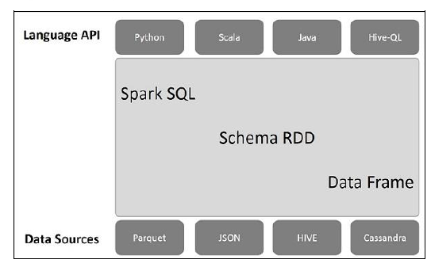
Architecture of SPARK SQL

Slide 47
SPARK SQL
Language API − Spark is compatible with different languages and Spark SQL. It is also, supported by these languages- API (python, scala, java, HiveQL).
Schema RDD − Spark Core is designed with special data structure called RDD. Generally, Spark SQL works on schemas, tables, and records. Therefore, we can use the Schema RDD as temporary table. We can call this Schema RDD as Data Frame.
Data Sources − Usually the Data source for spark-core is a text file, Avro file, etc. However, the Data Sources for Spark SQL is different. Those are Parquet file, JSON document, HIVE tables, and Cassandra database.

Slide 48
Data frames and datasets
A DataFrame is a distributed collection of data, which is organized into named columns. Conceptually, it is equivalent to relational tables with good optimization techniques.
A DataFrame can be constructed from an array of different sources such as Hive tables, Structured Data files, external databases, or existing RDDs. This API was designed for modern Big Data and data science applications taking inspiration from DataFrame in R Programming and Pandas in Python.

Slide 49
Data frames and datasets
Here is a set of few characteristic features of DataFrame −
Ability to process the data in the size of Kilobytes to Petabytes on a single node cluster to large cluster.
Supports different data formats (Avro, csv, elastic search, and Cassandra) and storage systems (HDFS, HIVE tables, mysql, etc).
State of art optimization and code generation through the Spark SQL Catalyst optimizer (tree transformation framework).
Can be easily integrated with all Big Data tools and frameworks via Spark-Core.
Provides API for Python, Java, Scala, and R Programming.

Slide 50
Datasets
A Dataset is a strongly-typed, immutable collection of objects that are mapped to a relational schema. At the core of the Dataset API is a new concept called an encoder, which is responsible for converting between JVM objects and tabular representation.
The tabular representation is stored using Spark’s internal Tungsten binary format, allowing for operations on serialized data and improved memory utilization. Spark 1.6 comes with support for automatically generating encoders for a wide variety of types, including primitive types (e.g. String, Integer, Long), Scala case classes, and Java Beans.
Users of RDDs will find the Dataset API quite familiar, as it provides many of the same functional transformations (e.g. map, flatMap, filter). Consider the following code, which reads lines of a text file and splits them into words:

Slide 51
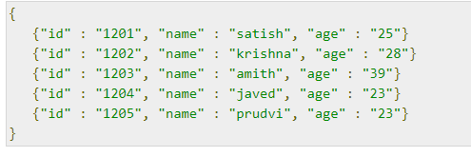
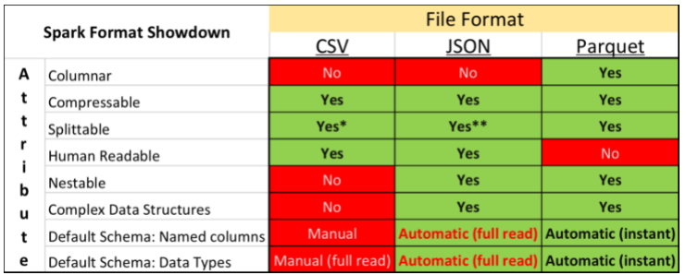
JSON and Parquet file formats
Apache Spark supports many different data sources, such as the ubiquitous Comma Separated Value (CSV) format and web API friendly JavaScript Object Notation (JSON) format. A common format used primarily for big data analytical purposes is Apache Parquet. Parquet is a fast columnar data format

Slide 52
JSON and Parquet file formats
Apache Parquet is a columnar storage format that can efficiently store nested data. Columnar formats are attractive since they enable greater efficiency, in terms of both file size and query performance. File sizes are usually smaller than row-oriented equivalents since in a columnar format the values from one column are stored next to each other, which usually allows a very efficient encoding.
A column storing a timestamp, for example, can be encoded by storing the first value and the differences between subsequent values (which tend to be small due to temporal locality: records from around the same time are stored next to each other). Query performance is improved too since a query engine can skip over columns that are not needed to answer a query.
A key strength of Parquet is its ability to store data that has a deeply nested structure in true columnar fashion. This is important since schemas with several levels of nesting are common in real-world systems.

Slide 53
JSON and Parquet file formats
AParquet uses a novel technique for storing nested structures in a flat columnar format with little overhead, which was introduced by Google engineers in the Dremel paper.1 The result is that even nested fields can be read independently of other fields, resulting in significant performance improvements.
Another feature of Parquet is the large number of tools that support it as a format. The engineers at Twitter and Cloudera who created Parquet wanted it to be easy to try new tools to process existing data, so to facilitate this they divided the project into a specification (parquet-format), which defines the file format in a language-neutral way, and implementations of the specification for different languages (Java and C++) that made.

Slide 54
JSON and Parquet file formats
Apache Parquet is column-oriented and designed to bring efficient columnar storage of data compared to row-based like CSV
Apache Parquet is built from the ground up with complex nested data structures in mind
Apache Parquet is built to support very efficient compression and encoding schemes (seeGoogle Snappy)
Apache Parquet allows to lower storage costs for data files and maximizes the effectiveness of querying data with serverless technologies like Amazon Athena, Redshift Spectrum, BigQuery, and Azure Data Lakes.

Slide 55
Scoop
Sqoop is a tool designed to transfer data between Hadoop and relational database servers. It is used to import data from relational databases such as MySQL, Oracle to Hadoop HDFS, and export from Hadoop file system to relational databases. This is a brief tutorial that explains how to make use of Sqoop in Hadoop ecosystem.

Slide 56
Scoop
The traditional application management system, that is, the interaction of applications with relational database using RDBMS, is one of the sources that generate Big Data. Such Big Data, generated by RDBMS, is stored in Relational Database Servers in the relational database structure.
When Big Data storages and analyzers such as MapReduce, Hive, HBase, Cassandra, Pig, etc. of the Hadoop ecosystem came into picture, they required a tool to interact with the relational database servers for importing and exporting the Big Data residing in them. Here, Sqoop occupies a place in the Hadoop ecosystem to provide feasible interaction between relational database server and Hadoop’s HDFS.
Sqoop − “SQL to Hadoop and Hadoop to SQL”
Sqoop is a tool designed to transfer data between Hadoop and relational database servers. It is used to import data from relational databases such as MySQL, Oracle to Hadoop HDFS, and export from Hadoop file system to relational databases. It is provided by the Apache Software Foundation.

Slide 57
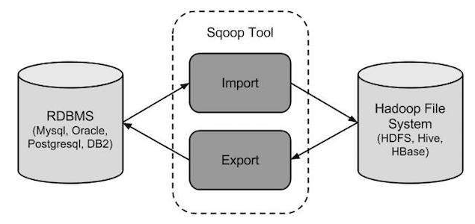
Scoop

Slide 58
Scoop Connectors
Sqoop has connectors for working with a range of popular relational databases, including MySQL, PostgreSQL, Oracle, SQL Server, and DB2. Each of these connectors knows how to interact with its associated DBMS. There is also a generic JDBC connector for connecting to any database that supports Java’s JDBC protocol. In addition, Sqoop Big data provides optimized MySQL and PostgreSQL connectors that use database-specific APIs to perform bulk transfers efficiently.

Slide 59
Scoop Import and export
Sqoop Import
The import tool imports individual tables from RDBMS to HDFS. Each row in a table is treated as a record in HDFS. All records are stored as text data in text files or as binary data in Avro and Sequence files.
Sqoop Export
The export tool exports a set of files from HDFS back to an RDBMS. The files given as input to Sqoop contain records, which are called as rows in table. Those are read and parsed into a set of records and delimited with user-specified delimiter.

Slide 60
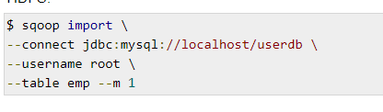
Scoop
The following syntax is used to import data into HDFS.
$ sqoop import-all-tables (generic-args) (import-args)
$ sqoop-import-all-tables (generic-args) (import-args)
$ sqoop import (generic-args) (import-args)
$ sqoop-import (generic-args) (import-args)

Slide 61
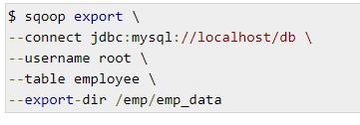
Scoop
Syntax
The following is the syntax for the export command.
$ sqoop export (generic-args) (export-args)
$ sqoop-export (generic-args) (export-args)

Slide 62
References
References
1) https://spark.apache.org/docs/latest/cluster-overview.html
2) https://intellipaat.com/blog/tutorial/spark-tutorial/spark-architecture/
3) http://commandstech.com/spark-lazy-evaluation-with-example/
4) https://www.edureka.co/blog/pyspark-programming/
5) https://data-flair.training/blogs/apache-spark-lazy-evaluation/

Slide 63
Thank You

